Slide 1
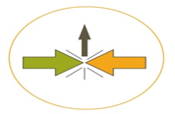
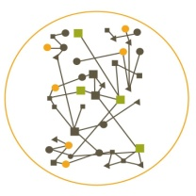


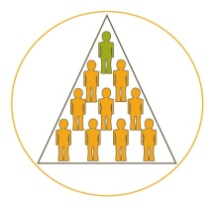

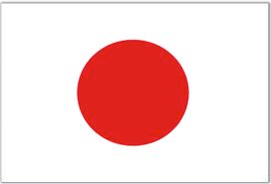



PDI
IDV
MAS
UAI
Keywords: Competition, level playing field, rules for fair competition, Risk taking, Enterprising, Pragmatism, Best practices,, Inductive, action orientated thinking, Practitioners highest esteem
Australia, UK, Ireland, New Zealand, USA
PDI
IDV
MAS
UAI
Keywords: Autonomy, consensus decision-making, incrementalism, Interdependence, Cooperation, Truth is found in the middle, Boss is coordinator. Mix of Inductive and deductive thinking
Denmark, Norway,
the Netherlands, Sweden, Finland
Austria, Czech Republic, Hungary, Germany, Switzerland (German), Finland
PDI
IDV
MAS
UAI
Keywords: Autonomy, Decentralization, High need for structures and procedures, Process standardization, Deductive thinking, Experts highest esteem
Belgium, France, Northern Italy, Spain, Switzerland (French), Poland
PDI
IDV
MAS
UAI
Keywords: Tension between hierarchy and individualism, rules and formality, Boss is connected Intellectual playing the system, Deductive thinking: Philosophy of…
Central- and South-America, Greece, Southern Italy, Iraq, Iran, South Korea, Portugal, Russia, Thailand, Turkey, African countries
PDI
IDV
MAS
UAI
Key words: Hierarchy, Centralisation. Implicit order, Formality, Procedures, Boss is strict but fair parent, Deductive thinking
China, Hong Kong, India, Indonesia, Malaysia, Singapore,
IDV
Keywords: Loyalty, Hierarchy, Simple structure, Flexibility, Boss is strict, but caring parent, Tendency for inductive thinking
PDI
MAS
UAI
Keywords: Perseverance, constant improvement, HoRenSo, Megawashi, Loyalty, Hierarchy, Dynamic Balance, check after check
Japan
PDI
idv
mas

